Slide 1
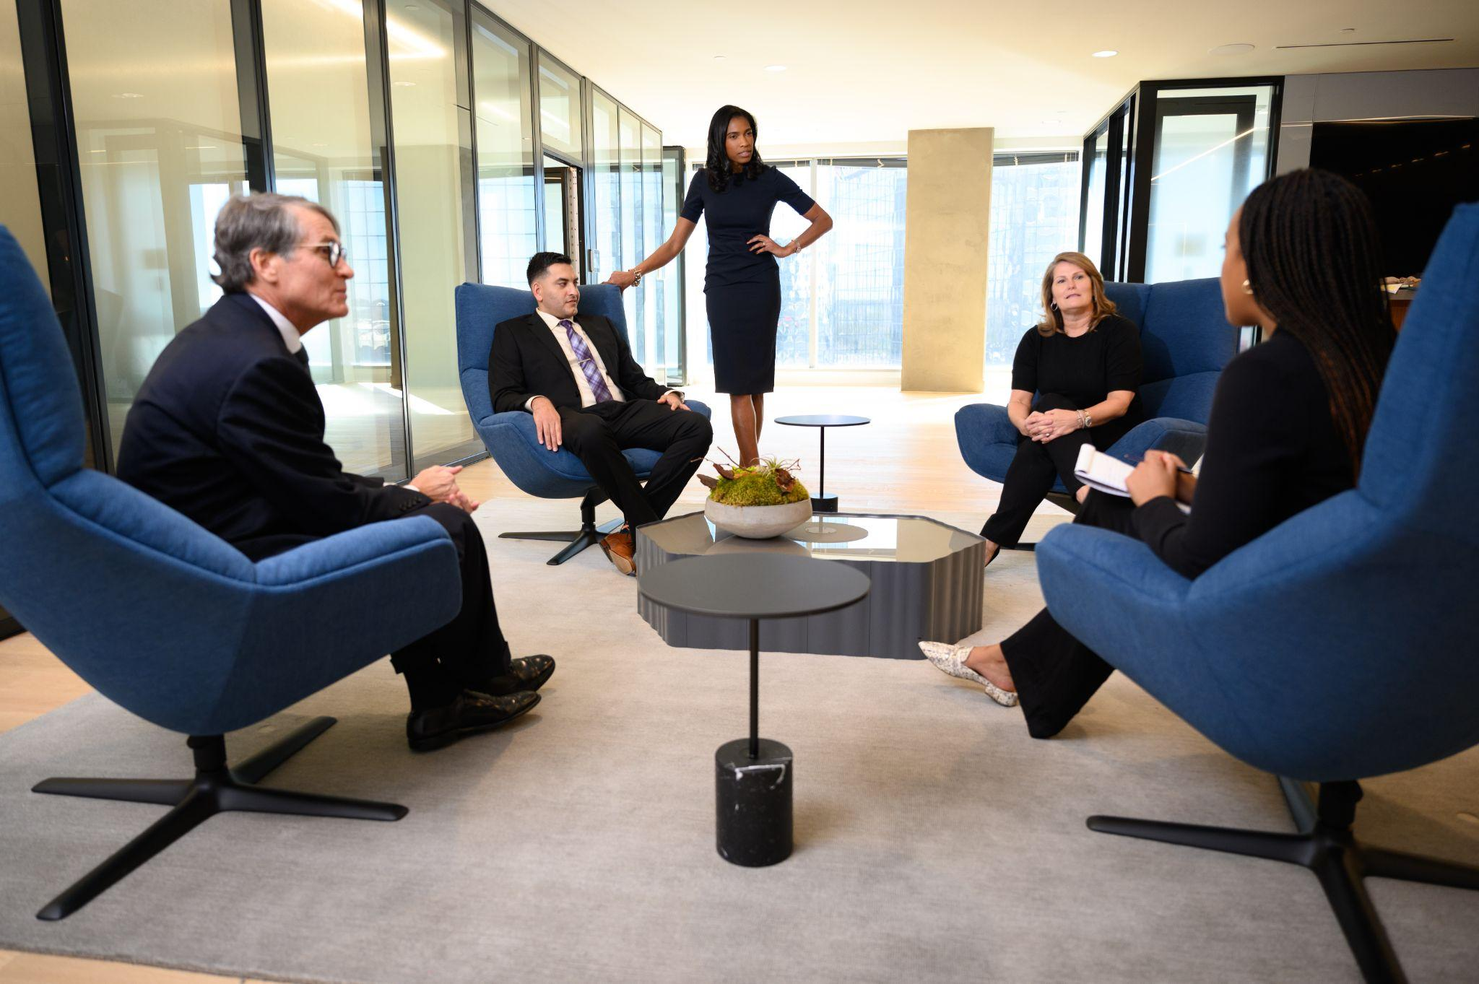
NATIONAL MEDIATION, ARBITRATION & DISPUTE MANAGEMENT SERVICES
www.Alterityadr.com

Slide 2
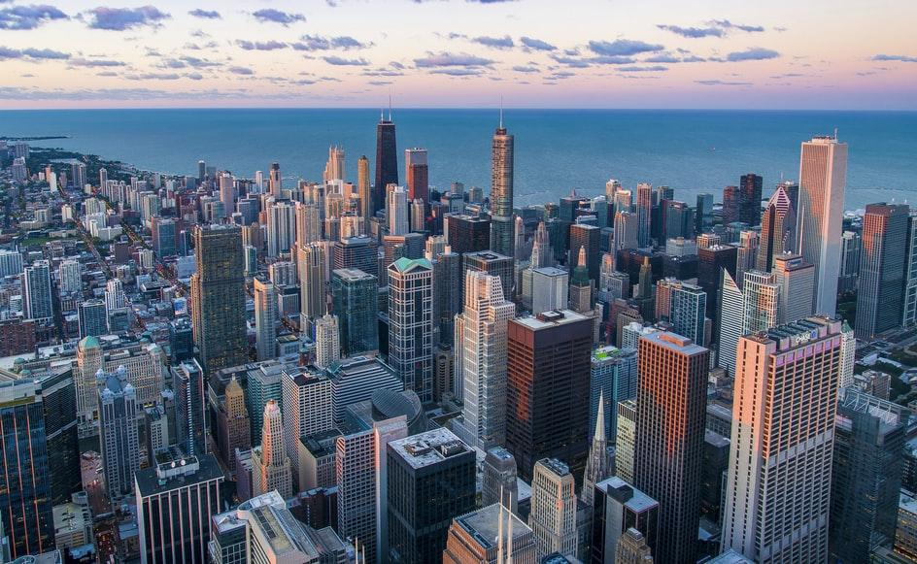
OUR MISSION
www.Alterityadr.com

Slide 3
OUR MISSION
To offer better dispute resolution that is more accessible, representative and restores relationships between individuals and institutions. Better Options. Better Resolution. Better Future.

Slide 4
OUR SERVICES
www.Alterityadr.com

Slide 5
OUR SERVICES
Mediation
Arbitration
Special Master
Facilitation
Early Neutral Evaluation
Pro Tem Trial
Early Resolution Program
Agile Negotiation
Appellate Review
Virtual ADR

Slide 6
WHAT MAKES US DISTINCTIVE

Slide 7
WHAT MAKES US DISTINCTIVE
To provide the best dispute resolution process available, Alterity ADR maintains a national panel of highly-qualified arbitrators. Alterity is committed to clarity, flexibility, and excellent service so that you can be confident of a well thought out and fair resolution. Our arbitration rules outline a clear process to facilitate proceedings while allowing you to customize your experience based on the unique nature of your dispute.

Slide 8
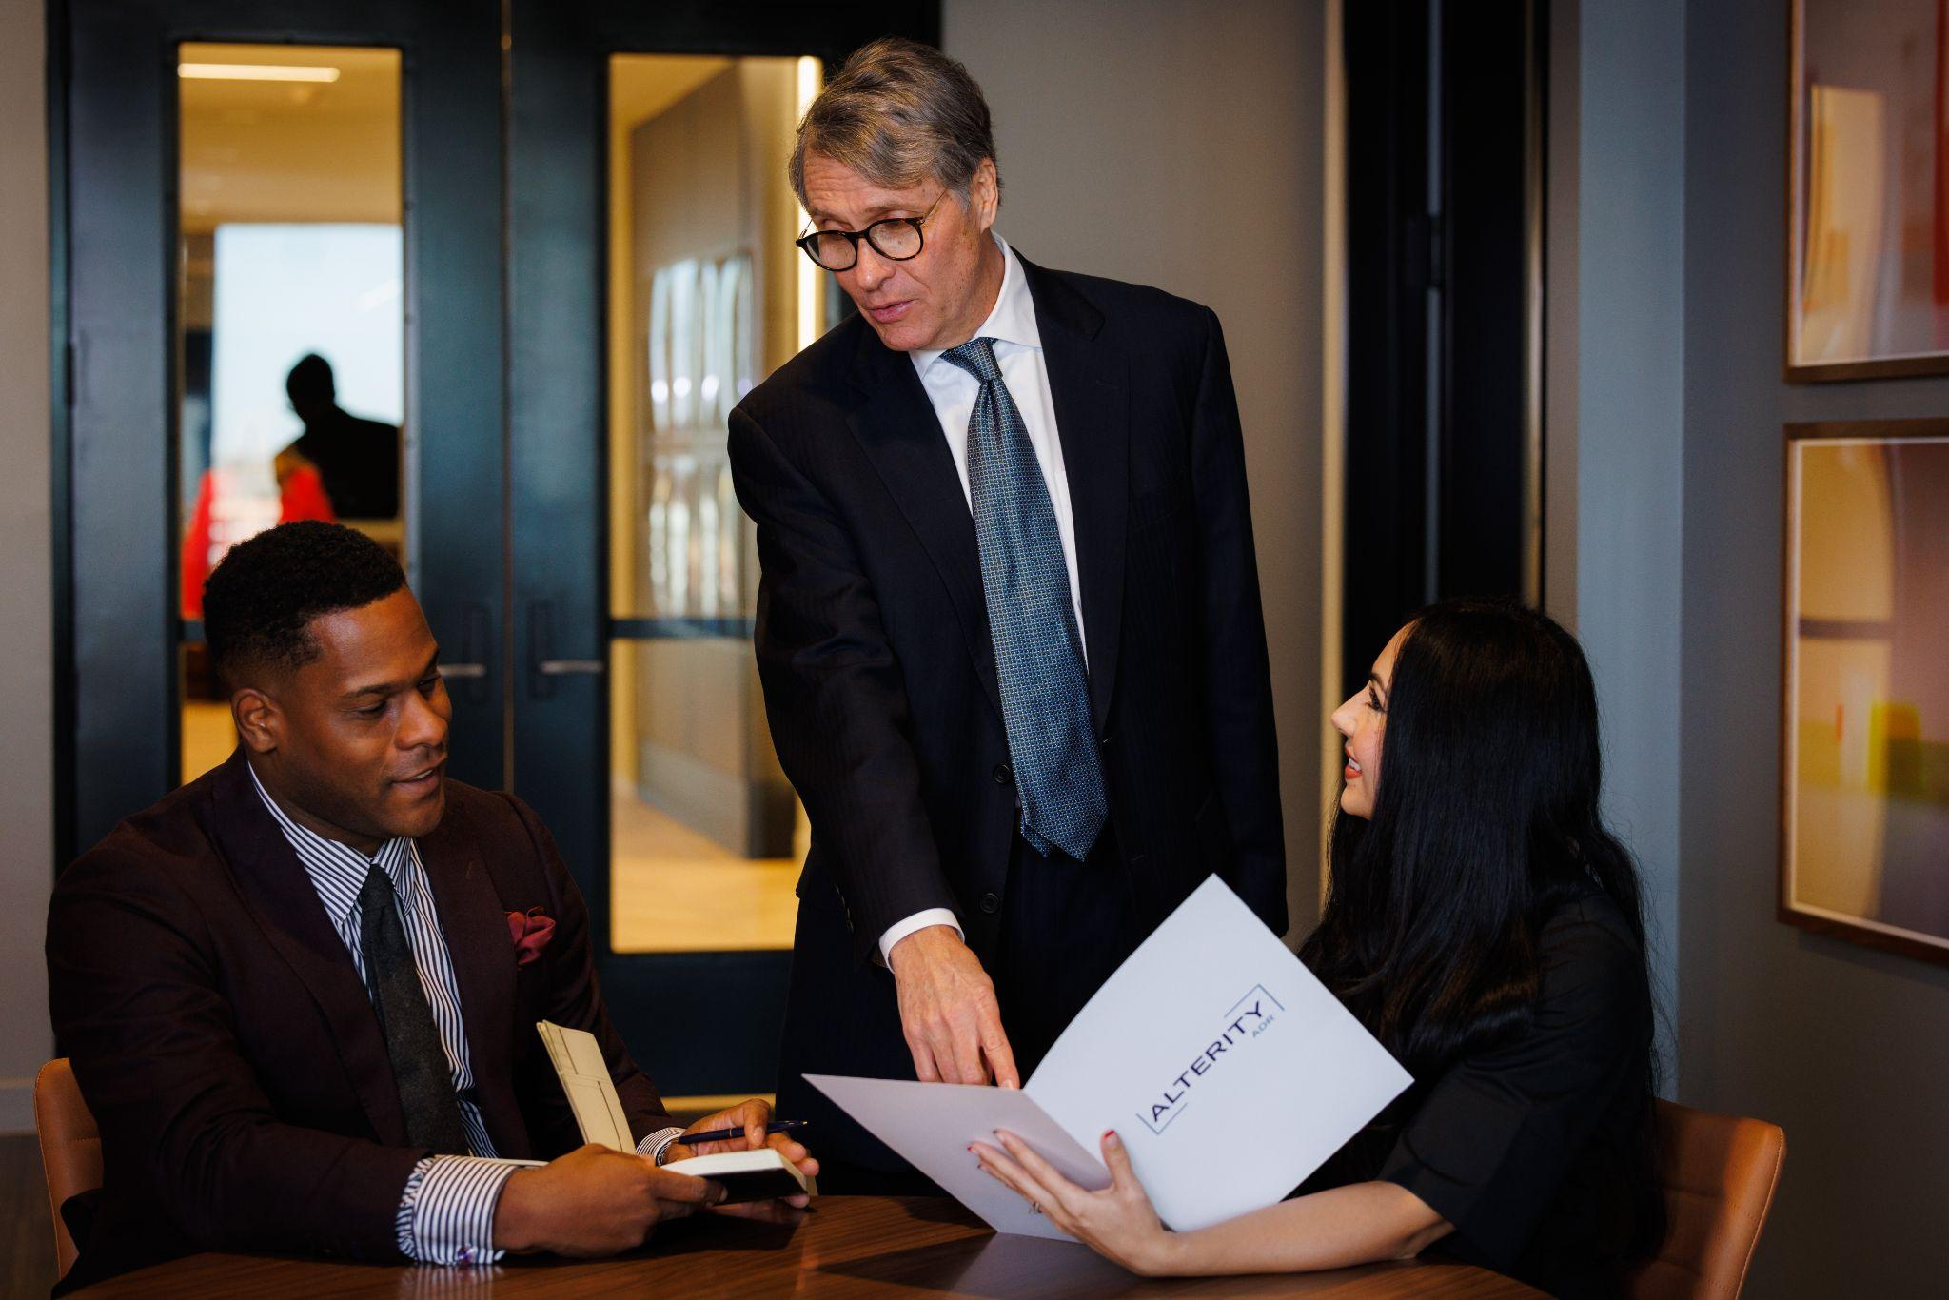
ARBITRATION PROCESS

Slide 9
ARBITRATION PROCESS
Alterity strives for a streamlined case initiation and management process to achieve a prompt, efficient, and satisfactory resolution of disputes. “We all know that arbitration can be slow, tedious, expensive, and more about the arbitrator(s) needs than the parties’ needs. You will not have that experience with Alterity.”

Slide 10
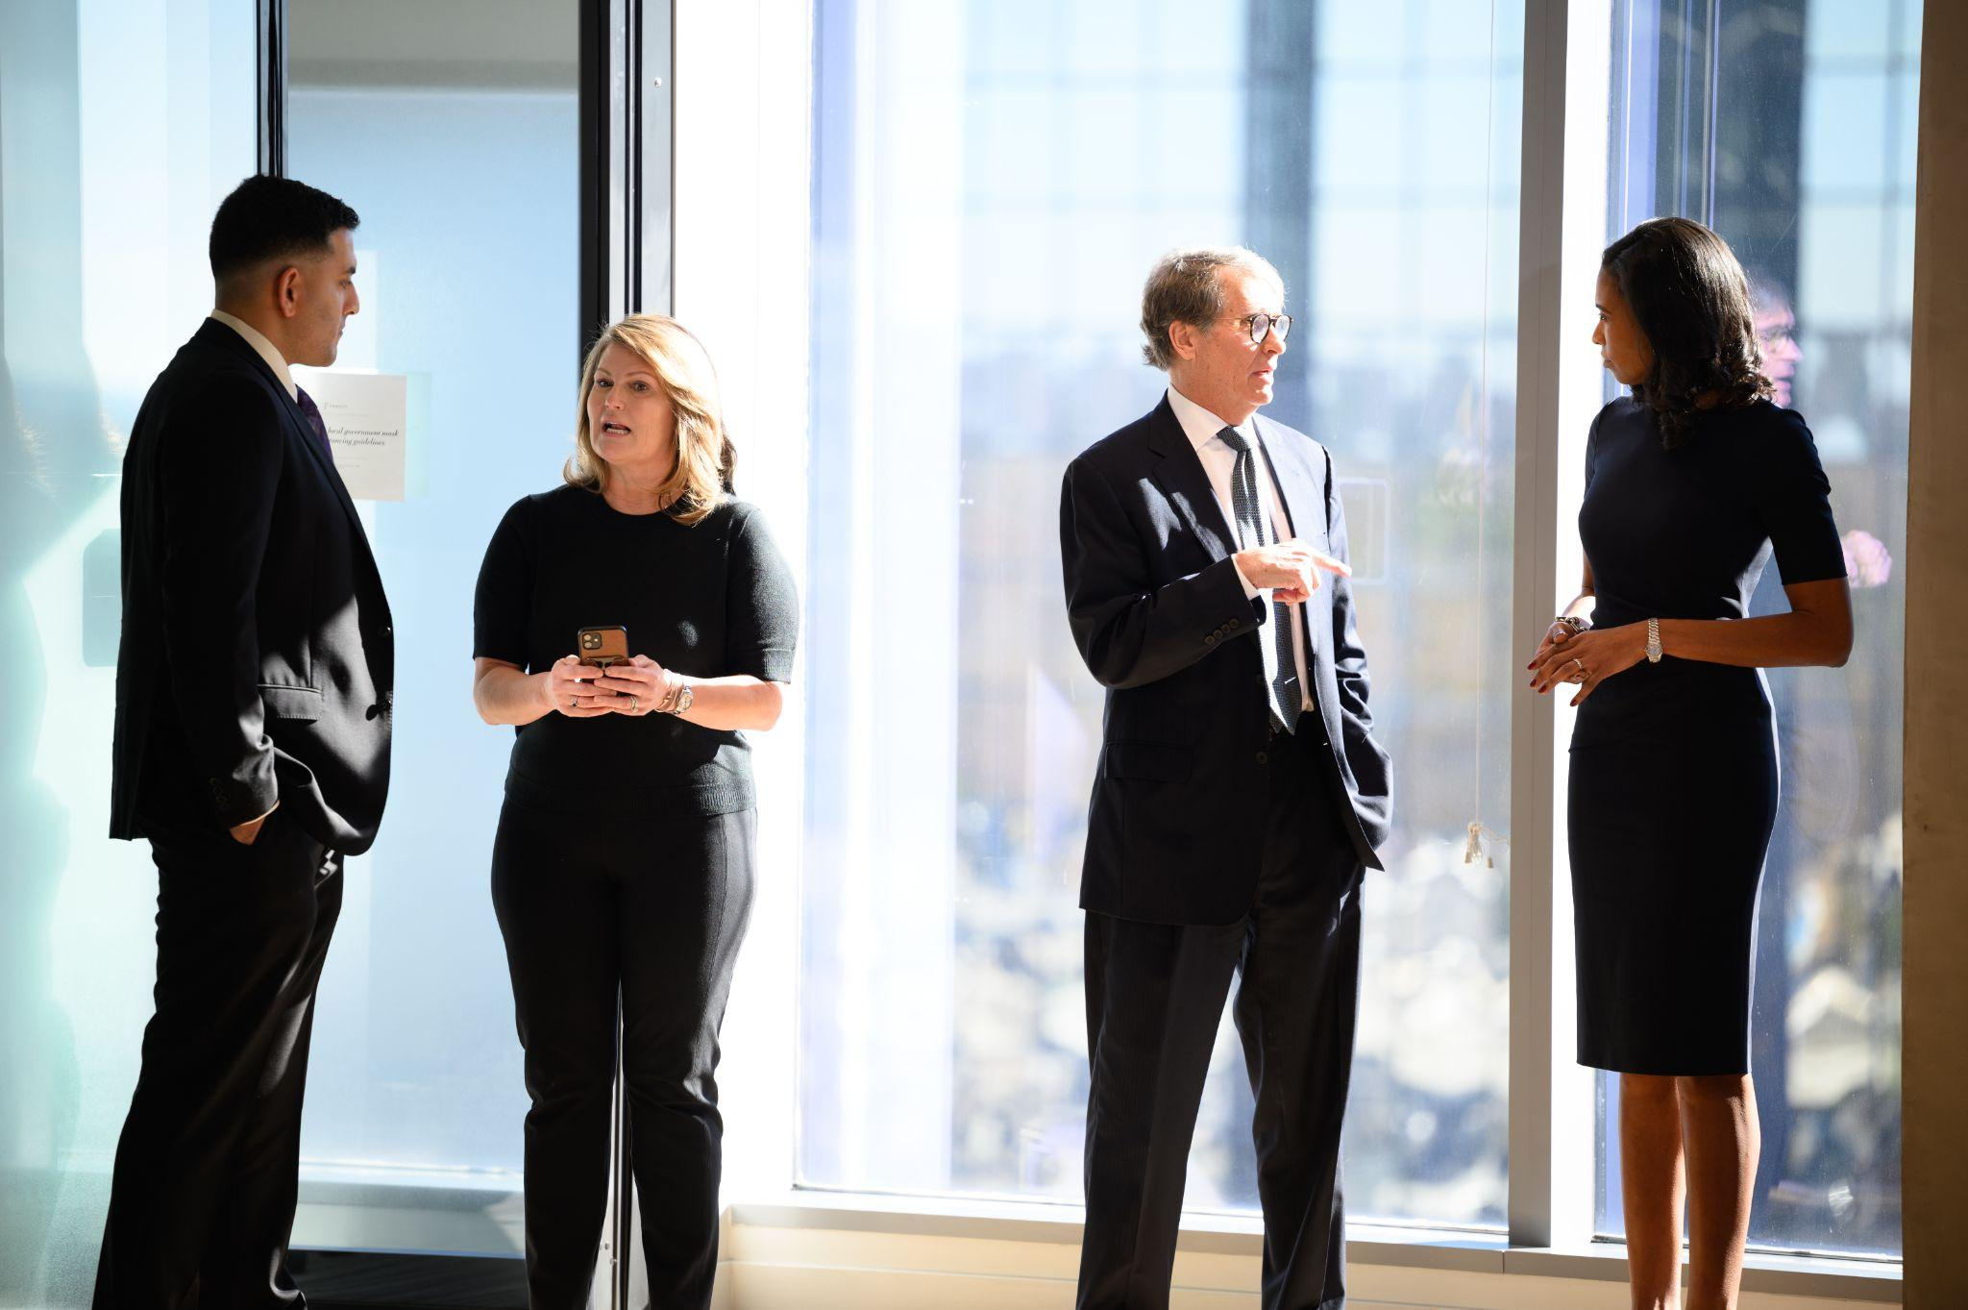
ARBITRATORS

Slide 11
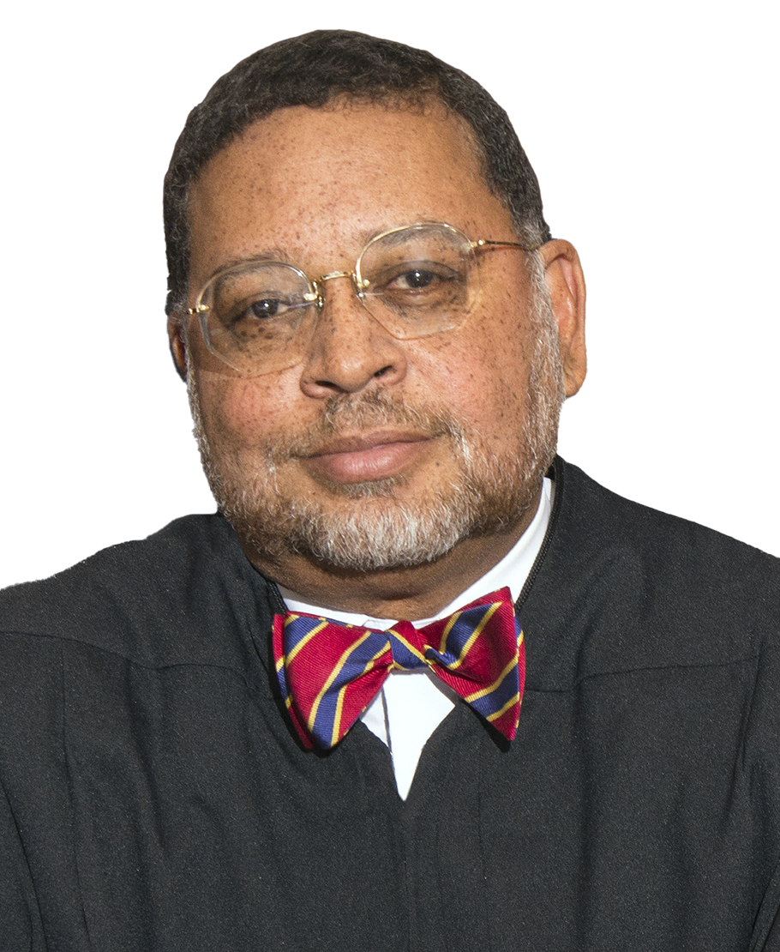
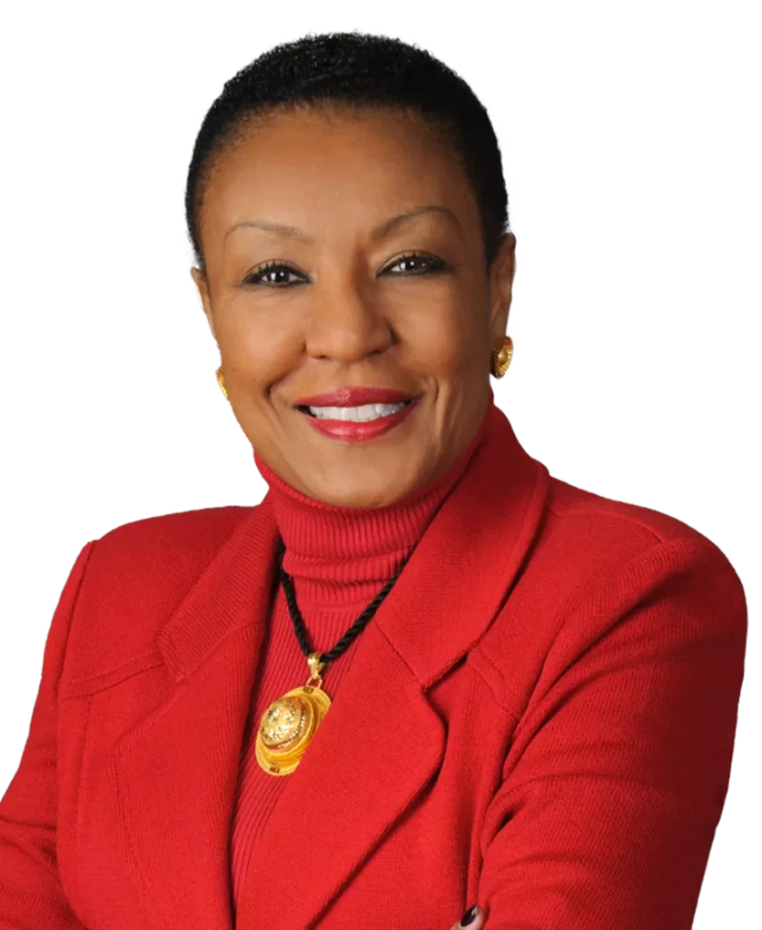
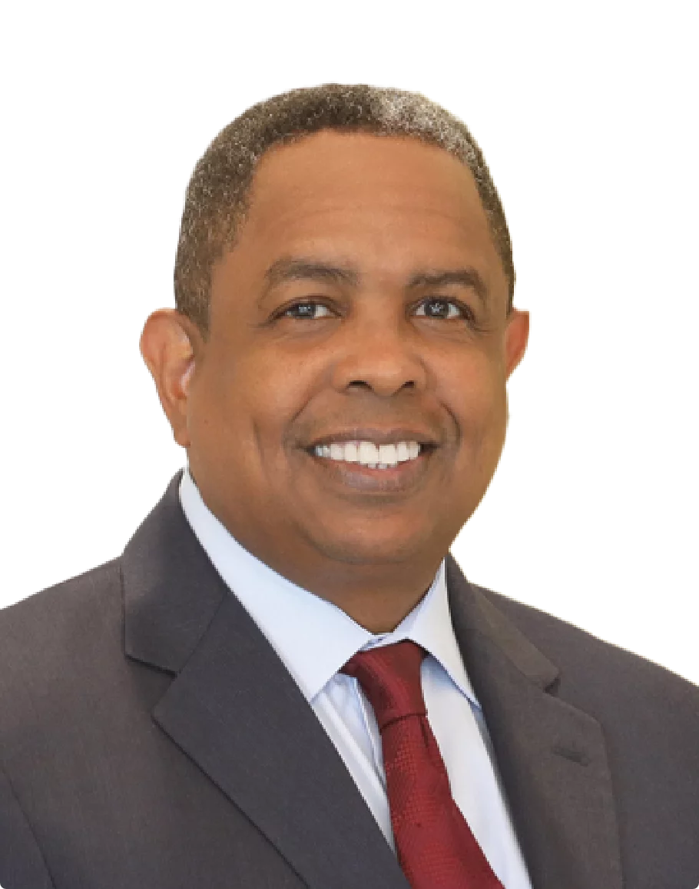
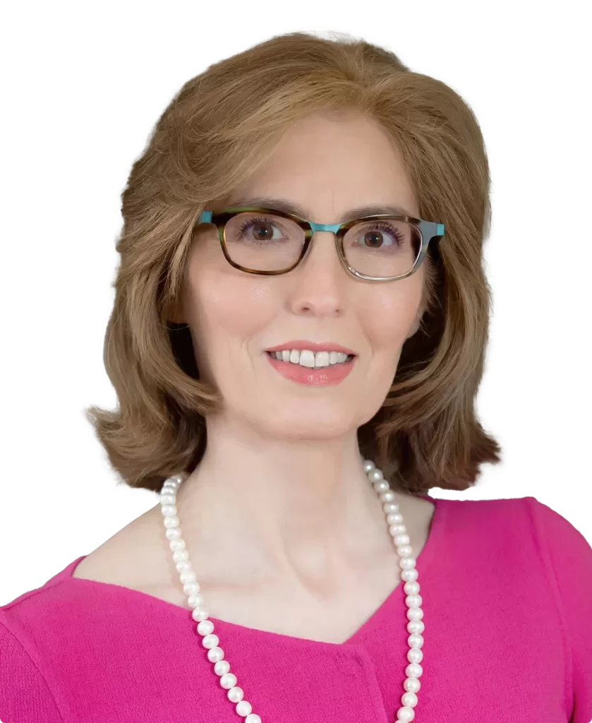
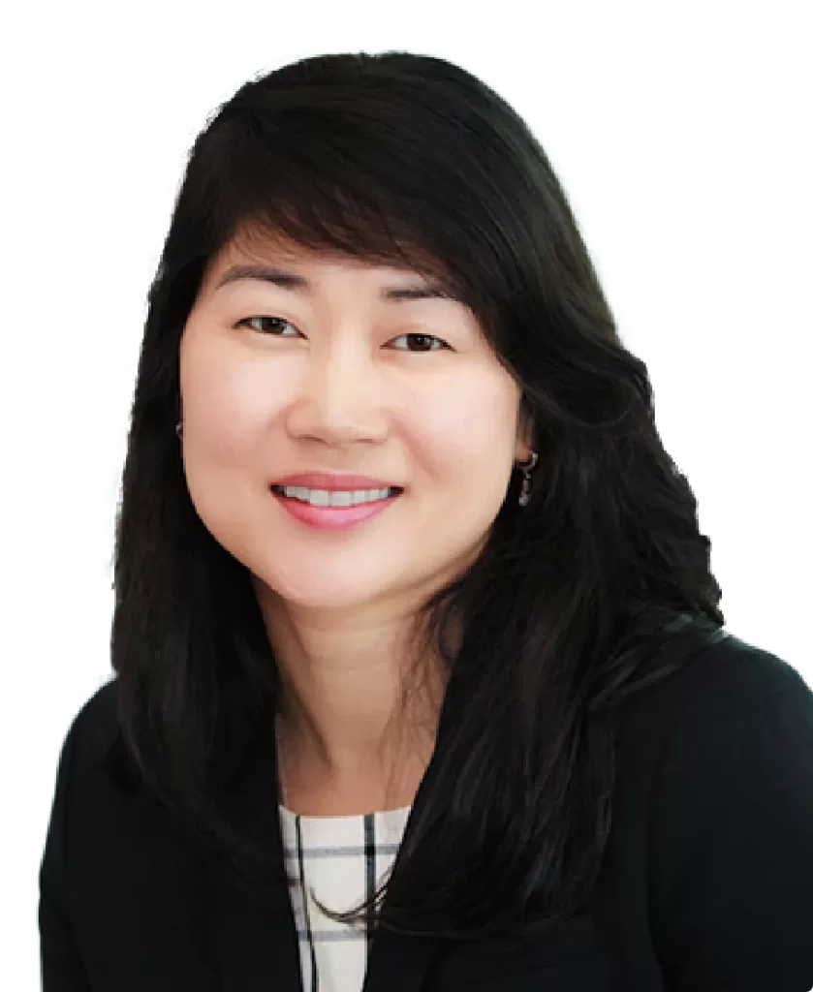
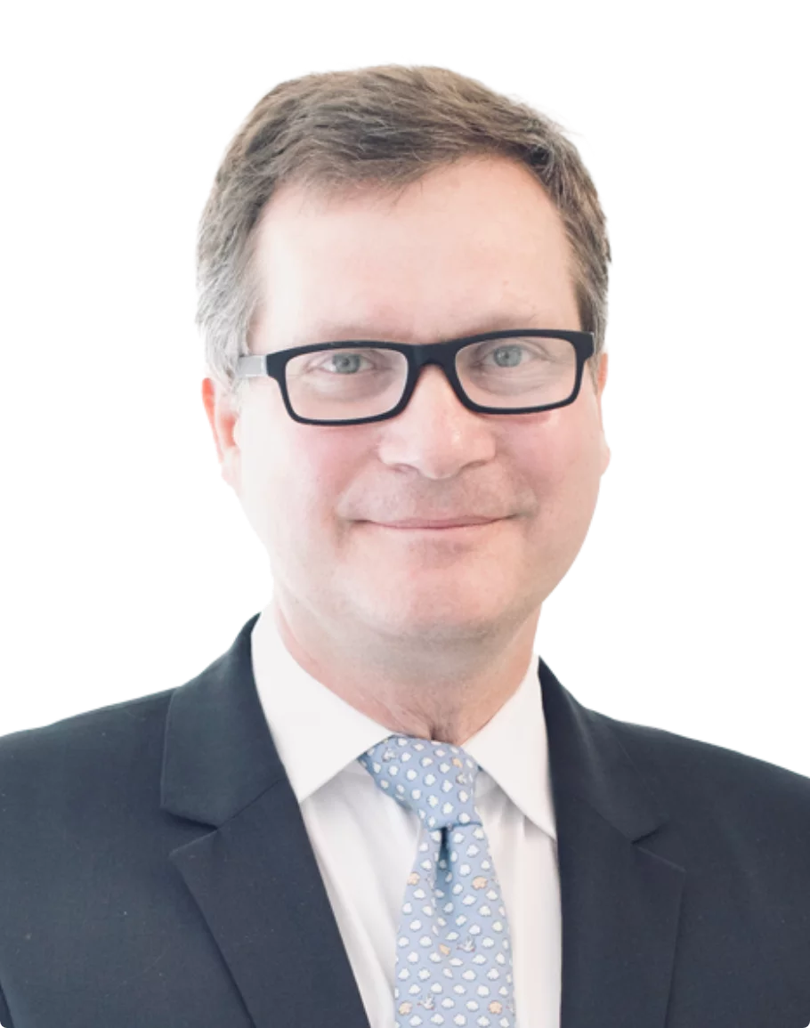
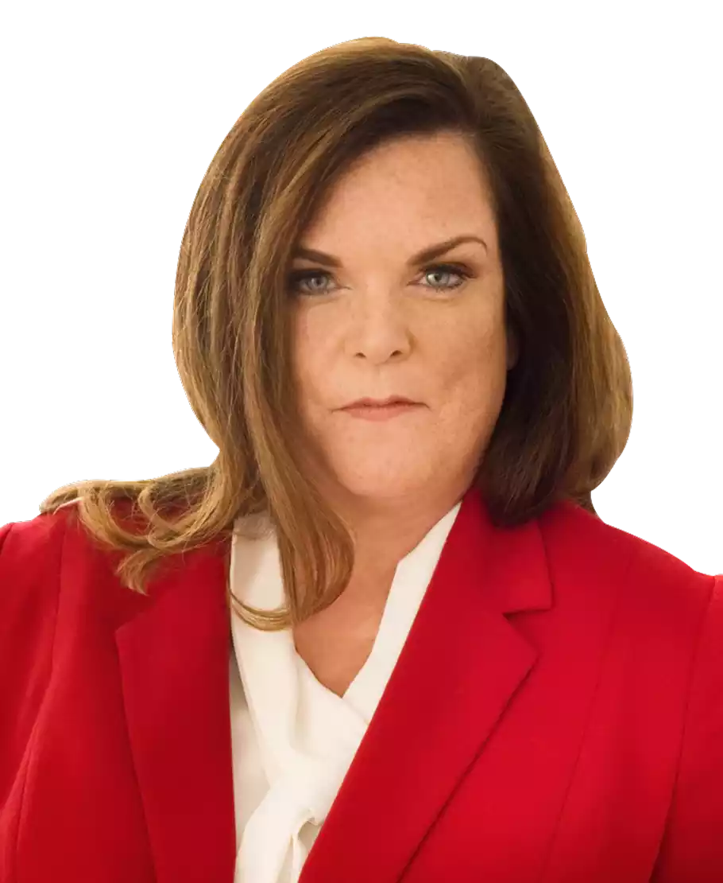
ARBITRATORS
Hon. Robert Young Jr. (Ret)
Hon. Leah Ward Sears (Ret)
Chaka Patterson
Linda Klein
Julie Jun
Nigel Wright
Hon. Kristi Harrington

Slide 12
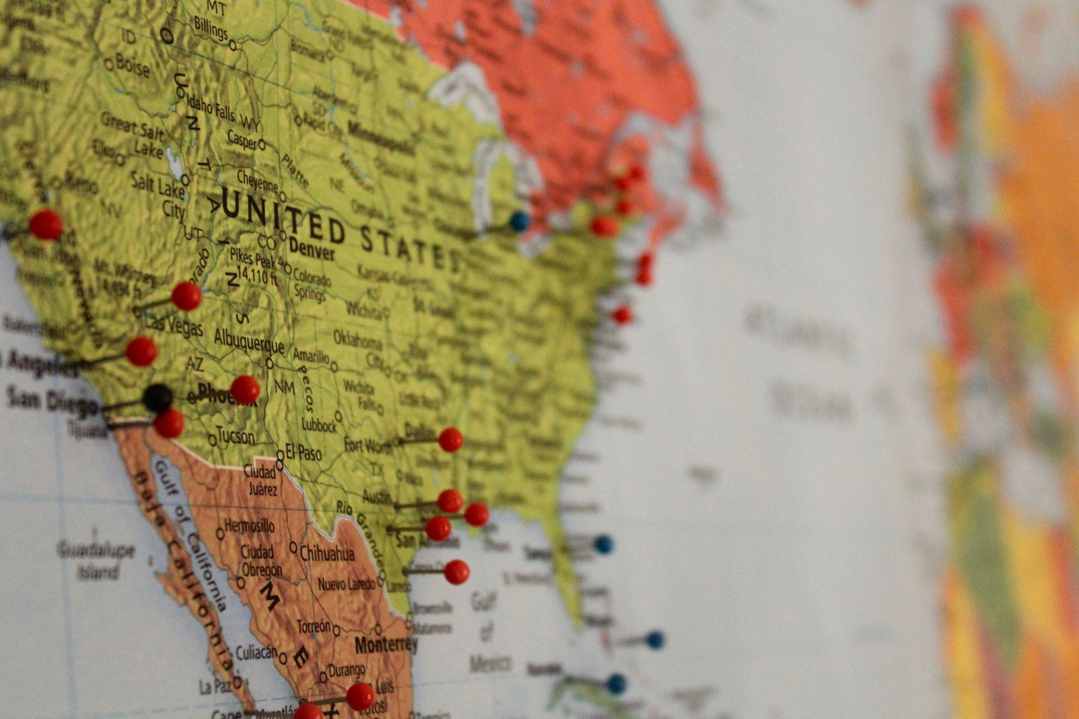
GEOGRAPHICAL SCOPE

Slide 13
GEOGRAPHICAL SCOPE
Atlanta
Charlotte
Charleston
Chicago
Dallas
Detroit
Florida
Fort Lauderdale
Houston
Las Vegas
Los Angeles
Miami
New York
San Antonio
San Francisco
Seattle
Washington, DC

Slide 14
COVID RESURGENCE/ VIRTUAL CAPACITY
www.Alterityadr.com

Slide 15
COVID RESURGENCE/ VIRTUAL CAPACITY
Virtual ADR is here to stay. Our virtual capacity for arbitration is possible due to the availability of a national team of efficient advocates. Our process facilitates the pre-hearing exchange of information, including evidence, documents and witness statements necessary for your arbitration.

Slide 16
CHAKA PATTERSON
THANK YOU
chaka@alterityadr.com 888-258-1237 alterityadr.com

